Slide 1
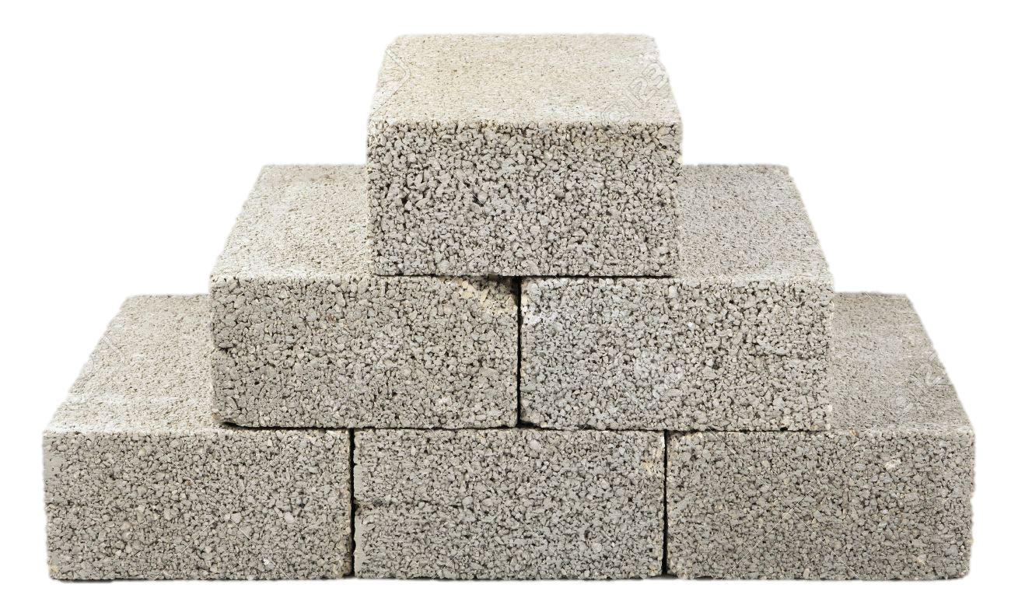
Foundationalism
Kareem Khalifa
Philosophy Department
Middlebury College

Slide 2
Overview
Background
What kinds of beliefs are basic?
What makes a belief basic?
Epistemic Ascent
Reasoning & Memory

Slide 3
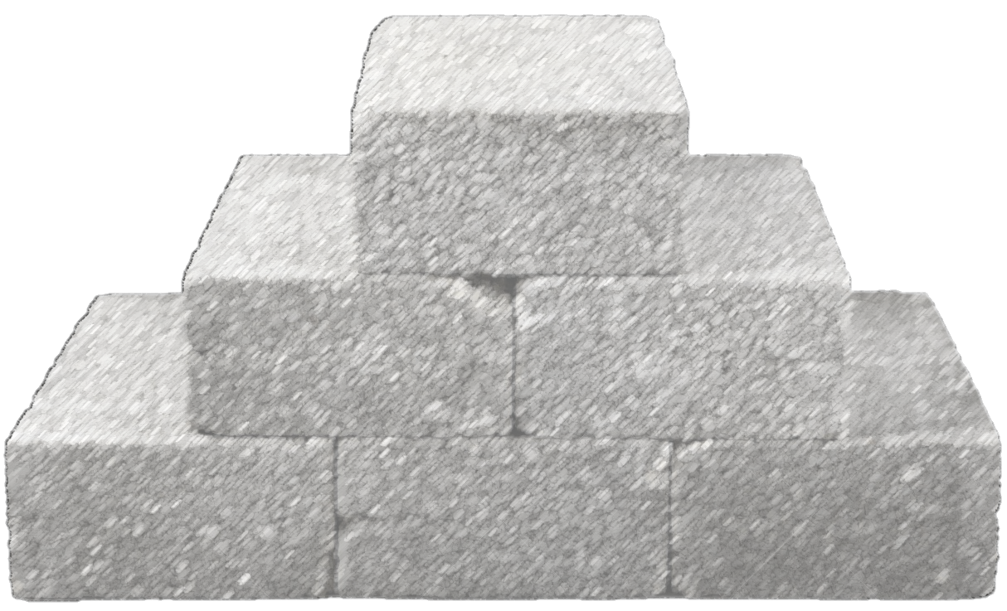
1. Background

Slide 4
2. What kinds of beliefs are basic?
2.1. Two candidates
2.2. Physical-object beliefs aren’t basic

Slide 5
3. What makes a belief basic?
3.1. Incorrigibility
3.2. Prima Facie Justification
3.3. General problems

Slide 6
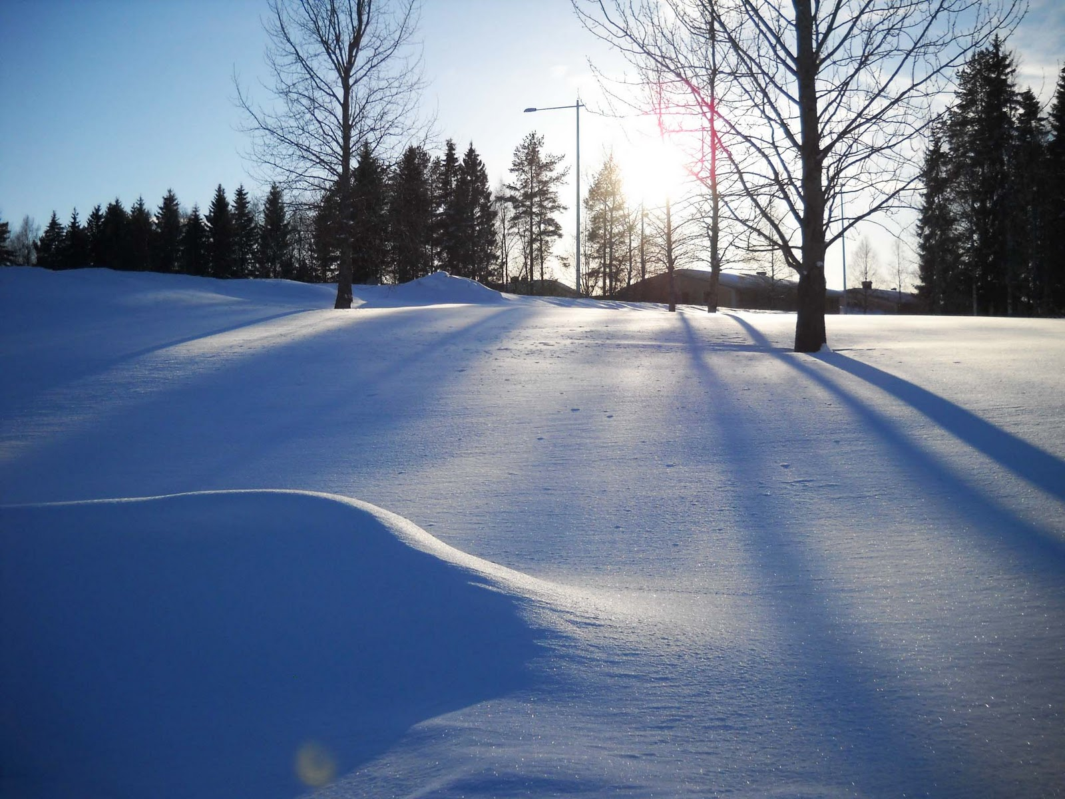
3.1. Incorrigibility

Slide 7
3.2. Prima Facie Justification

Slide 8
3.3. General Problem With Basic Beliefs

Slide 9
4. Epistemic Ascent
A belief P is a reason for S to believe Q iff it is logically possible for S to become justified in believing Q by believing it on the basis of P.
4.1. Defeasible Reasons
4.2. Arguments
4.3. The Problem of Perception

Slide 10
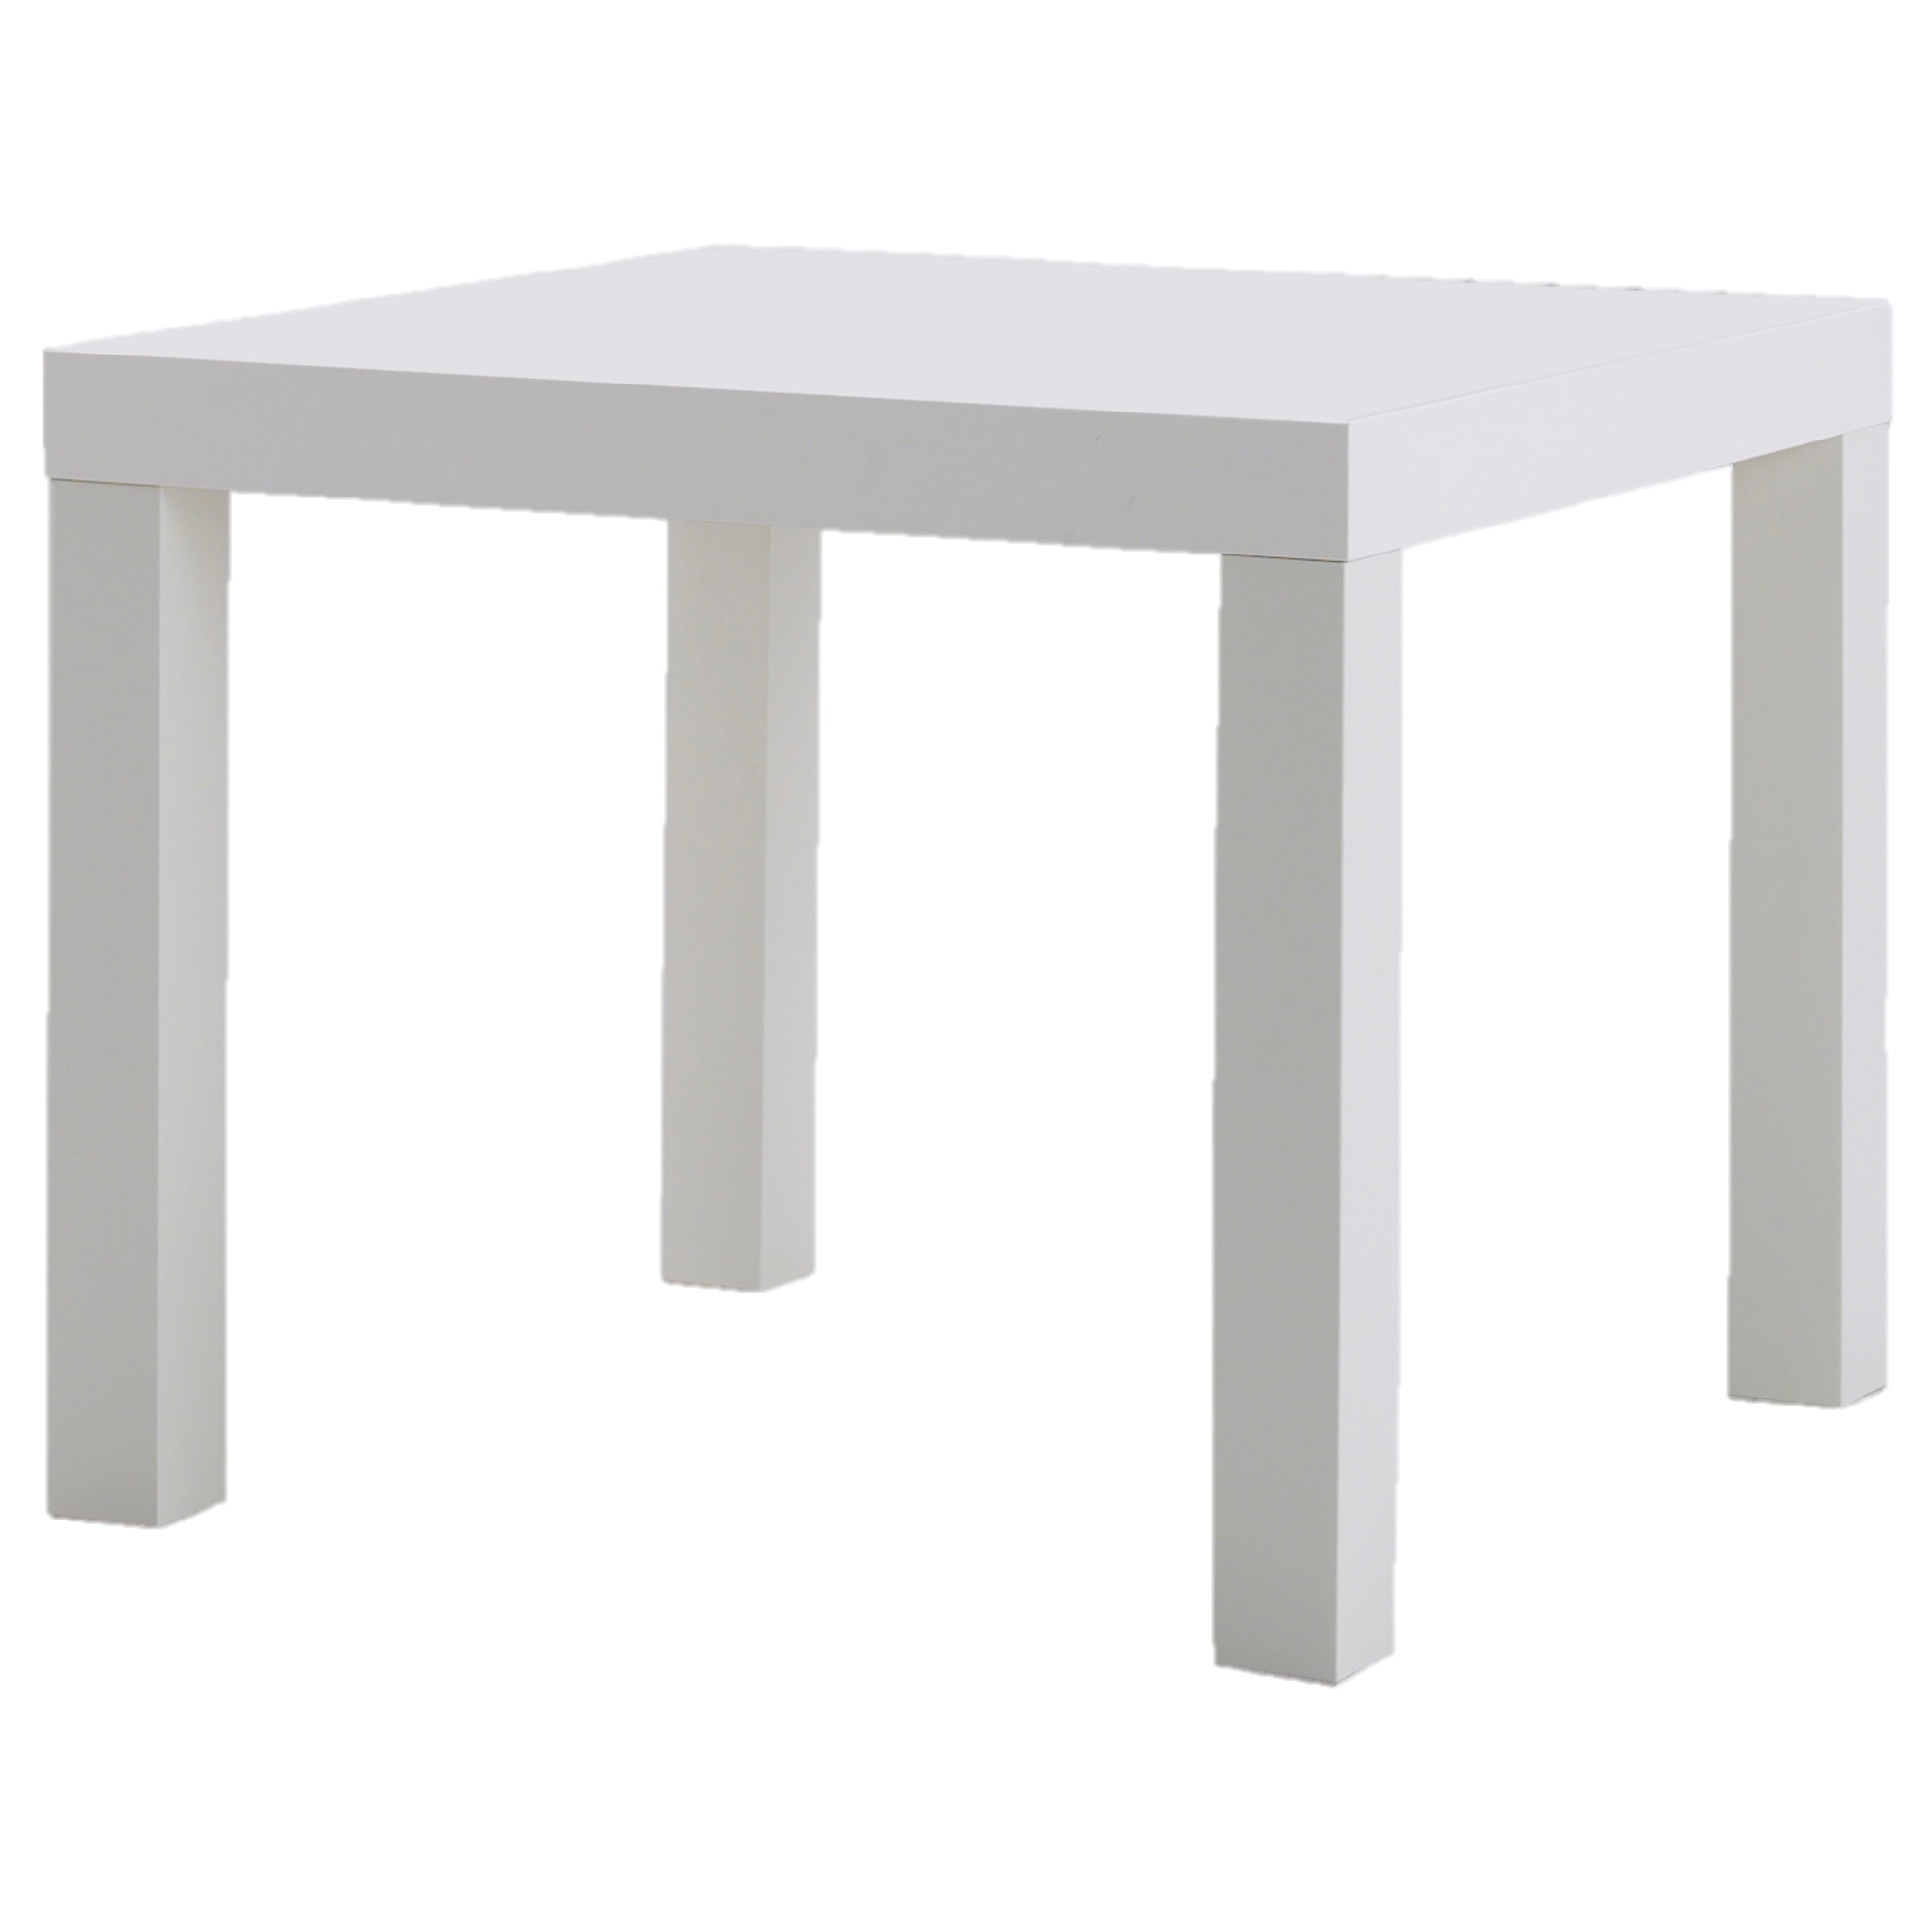
4.1. Defeasible Reasons
P
Q
R
If P is a reason for S to believe Q, then R is a defeater for this reason iff (P&R) is not a reason for S to believe Q.

Slide 11
4.2. Justified Belief & Undefeated Argument
S’s belief that P is justified if and only if S instantiates an undefeated argument supporting P.
My belief that the table is red is justified iff…
Argument A
1. The table appears red to me.
2. If the table appears red to me, then the table is red.
3. The table is red.
Argument C (Defeater-Eater)
I recently changed the lights and they’re white.
So the lights are not red.
Argument B (Defeater)
The table appears red to me.
The lights are red.
If the lights are red, then even if the table appears red to me, it may be white.
The table may be white.

Slide 12
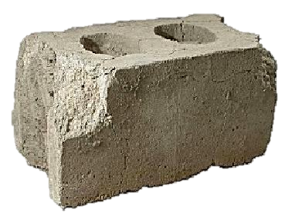
4.3. Problem of Perception

Slide 13
4.3. Problem of Perception
4.3.1. Deductive
4.3.2. Inductive
4.3.3. Explanatory
4.3.4. Scientific Realism
4.3.5. Defeasible

Slide 14
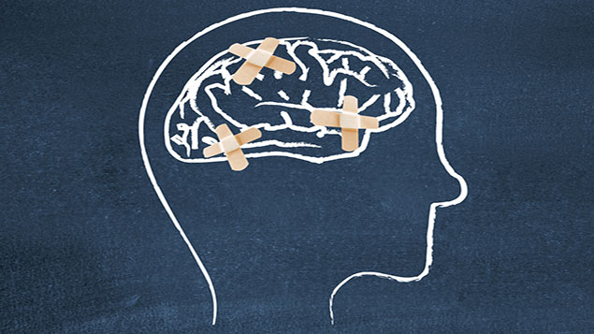
5. Reason & Memory
5.1. Occurrent thoughts
5.2. Memory & knowledge
5.3. Genetic & dynamic arguments

